Slide 1

CSE 499A · Group 06
PRIVATE
SHIELD
Privacy-Preserving Federated Intelligence System for IoT Threat Detection
Group 06 | Md. Murad Ul Momin | Rima Saha | Sakia Tabassum Anonna | Ashraful Hossain Riyan

Slide 2
PROBLEM
Why this project is needed
IoT devices are easy targets because many have weak security.
Main challenge
Centralized IDS needs raw traffic in the cloud.
Keep IoT data private while still detecting attacks and blocking bad clients.
That can expose private data and use high bandwidth.
Federated Learning helps, but model updates can still be attacked.
This is why PRIVATE SHIELD combines FL, privacy, attack defense and dashboard alerts.
Weak
IoT node
Raw data
sent out
Privacy
risk
Model
attack
Hard to
explain
Group 06 | Md. Murad Ul Momin | Rima Saha | Sakia Tabassum Anonna | Ashraful Hossain Riyan

Slide 3
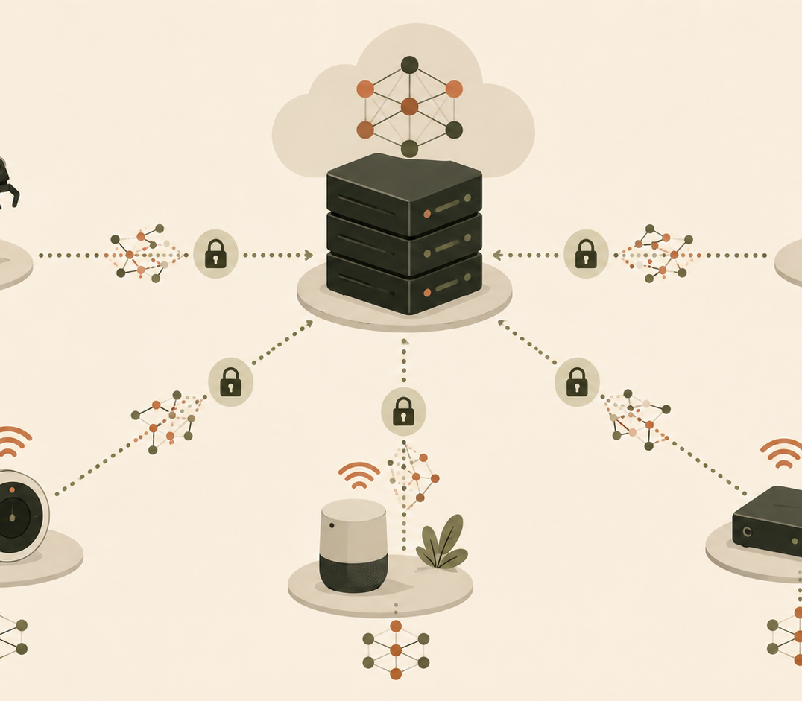
PROJECT IDEA
What PRIVATE SHIELD does
Each IoT client keeps its own traffic data.
A small model trains locally on that client.
Only model updates are shared with the server.
The server checks, filters and combines updates.
A dashboard shows alerts in simple language.
Simple meaning: learn together without giving away raw traffic.
Group 06 | Md. Murad Ul Momin | Rima Saha | Sakia Tabassum Anonna | Ashraful Hossain Riyan

Slide 4
ARCHITECTURE
Full system flow
IoT traffic
local data
Preprocess
features
Local model
training
DP + gradient
clipping
Check update
quality
Two main protections are applied before the server trusts an update:
FedAvg
aggregation
Privacy layer: clipped + noisy updates
Defense layer: suspicious updates get less weight or are rejected
Global model
returns
SOC dashboard
alerts
Group 06 | Md. Murad Ul Momin | Rima Saha | Sakia Tabassum Anonna | Ashraful Hossain Riyan

Slide 5
RESEARCH BASE
Papers used in the project
1
SecureDyn-FL
2
FedMADE
Basic FL intrusion-detection prototype with N-BaIoT style data, simulated clients and global model update.
Dynamic aggregation: models that help more attack classes receive stronger global influence.
3
WEF-Defense
4
FedMSE
Free-rider detection by checking if model weights really evolve during local training.
Semi-supervised anomaly detection using normal-only training, autoencoder and MSE-based aggregation.
We used the papers as implementation guides, not as final result claims.
Final performance must be measured using our own dataset split, client count and training settings.
Group 06 | Md. Murad Ul Momin | Rima Saha | Sakia Tabassum Anonna | Ashraful Hossain Riyan

Slide 6
DATA + MODELS
How the experiments are prepared
Data source
N-BaIoT-compatible features and simulated IoT traffic
Client split
IID and non-IID partitions to imitate different devices
Models
1D-CNN, local classifiers, autoencoder and centroid detector
Metrics
Accuracy, precision, recall, F1-score, AUC, time and communication cost
Fair test
same setup for all methods
Group 06 | Md. Murad Ul Momin | Rima Saha | Sakia Tabassum Anonna | Ashraful Hossain Riyan

Slide 7
IMPLEMENTATION 1
SecureDyn-FL basic prototype
Completed the basic end-to-end FL flow.
Current state
Prepared N-BaIoT-compatible preprocessing.
01
05
Split data across simulated clients.
basic prototype complete
main steps running
Trained local models and averaged updates at the server.
Tested basic IID and non-IID settings.
Advanced parts like encrypted aggregation, GMM/Mahalanobis auditing, pruning and full poisoning tests are planned next.
Group 06 | Md. Murad Ul Momin | Rima Saha | Sakia Tabassum Anonna | Ashraful Hossain Riyan

Slide 8
IMPLEMENTATION 2
FedMADE dynamic aggregation
Main idea: not every client should get the same importance.
Each local model predicts validation data.
Poisoned / weak
client update
Useful class-level
client update
A Class Probability Matrix shows class-level strength.
DBSCAN groups similar client behavior.
Better class-level contributors get higher weights.
Suspicious or weak updates receive very small weight.
Low
weight
High
weight
Group 06 | Md. Murad Ul Momin | Rima Saha | Sakia Tabassum Anonna | Ashraful Hossain Riyan

Slide 9
IMPLEMENTATION 3
WEF-Defense for free riders
Free-rider clients try to take the global model without real training.
Normal clients
WEF checks how much important weights actually change.
weights evolve
local training is visible
If a client has too little useful weight movement, it looks suspicious.
The server separates normal contributors from suspected free riders.
Free riders
low change
or fake contribution
Group 06 | Md. Murad Ul Momin | Rima Saha | Sakia Tabassum Anonna | Ashraful Hossain Riyan

Slide 10
IMPLEMENTATION 4
FedMSE semi-supervised detection
Main idea: learn normal traffic first, then flag what looks unusual.
Normal
data
Uses normal-only training for anomaly detection.
Shrink Autoencoder learns compact normal behavior.
Shrink
autoencoder
Centroid distance helps find abnormal traffic.
MSEAvg gives more weight to models with lower reconstruction error.
Centroid
check
Useful when new attacks are not fully labeled.
Anomaly
alert
Group 06 | Md. Murad Ul Momin | Rima Saha | Sakia Tabassum Anonna | Ashraful Hossain Riyan

Slide 11
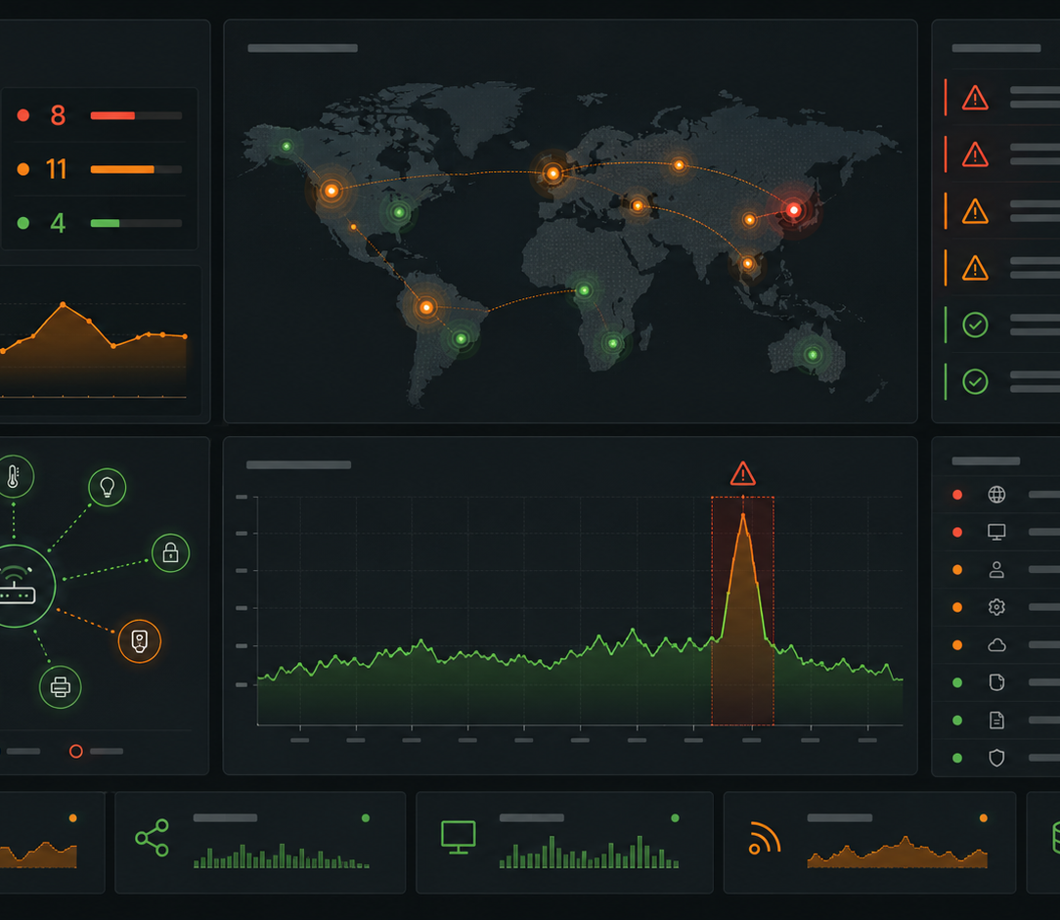
MONITORING
Dashboard and security view
Shows live device status and alerts.
Tracks attack type, model status and client reputation.
WebSockets update the page without refresh.
LLM summaries can explain alerts in plain language.
Raw private traffic is not sent to the language model.
Goal: help an admin understand what happened quickly.
Group 06 | Md. Murad Ul Momin | Rima Saha | Sakia Tabassum Anonna | Ashraful Hossain Riyan

Slide 12
EVALUATION
What we will measure
Accuracy
F1-score
AUC
Latency
Comm. cost
Robustness
Centralized model vs federated model
IID vs non-IID device data
Normal clients vs poisoned / free-rider clients
With and without privacy and defense layers
Group 06 | Md. Murad Ul Momin | Rima Saha | Sakia Tabassum Anonna | Ashraful Hossain Riyan

Slide 13
CONCLUSION
Current status and next steps
What is done
Next
SecureDyn-FL basic prototype
Run all methods with the same data split.
FedMADE module
Compare all metrics fairly.
WEF-Defense module
Add stronger poisoning and free-rider tests.
FedMSE module
Connect the best parts into one PRIVATE SHIELD pipeline.
Initial system report and design
Prepare final dashboard demo.
Final message: PRIVATE SHIELD keeps IoT data local, checks model updates, and explains threats clearly.
Group 06 | Md. Murad Ul Momin | Rima Saha | Sakia Tabassum Anonna | Ashraful Hossain Riyan

Slide 14
REFERENCES
Main research papers used
[1] SecureDyn-FL: Robust privacy-preserving FL for IoT intrusion detection, arXiv:2601.06466, 2026.
[2] FedMADE: Dynamic aggregation for robust IoT intrusion detection, arXiv:2408.07152, 2024.
[3] WEF-Defense: Defense against free-rider attack using weight evolving frequency, arXiv:2206.05406, 2022.
[4] FedMSE: Semi-supervised federated learning for IoT network intrusion detection, Computers & Security, 2025.
Thank You
Group 06 | Md. Murad Ul Momin | Rima Saha | Sakia Tabassum Anonna | Ashraful Hossain Riyan

